Slide 1

BARE INTERNATIONAL
Customer Satisfaction Analysis
An In-depth Evaluation of Staff Interaction and Website Enquiries
Presented by: Vishal Yadav

Slide 2
OBJECTIVE
Evaluate Customer Experience:
Assess the overall satisfaction and experience of visitors at the center, focusing on various touchpoints such as website inquiry, center visit, reception, and interaction with the salesperson.
Identify Strengths and Weaknesses:
Highlight the positive aspects and areas needing improvement in the services, facilities, and customer interactions.
Analyze Follow-up Effectiveness:
Determine the effectiveness and timeliness of follow-up communications post-visit.
Regional and Group Analysis:
Compare the performance and customer satisfaction across different regions and between company-owned and franchisee centers.

Slide 3
METHODOLOGY
Data Cleaning and Preparation:
Convert date and time fields to appropriate datetime formats.
Handle missing values and standardize categorical data.
Descriptive Statistics:
Calculate summary statistics for numerical fields like evaluation scores and time taken for various activities.
Generate frequency distributions for categorical variables.
Sentiment Analysis:
Analyze textual feedback in fields like "Please elaborate" sections to gauge sentiment and identify common themes.
Comparative Analysis:
Compare customer satisfaction scores and other key metrics across (Conversion rate).

Slide 4
METHODOLOGY
Correlation Analysis:
Identify correlations between different variables, such as the relationship between website inquiry ease and overall satisfaction.
Visualization:
Create visualizations like bar charts, pie charts, and heatmaps to represent the data insights clearly.
Reporting:
Compile the findings into a comprehensive report, highlighting key insights, strengths, weaknesses, and actionable recommendations for improvement.

Slide 5
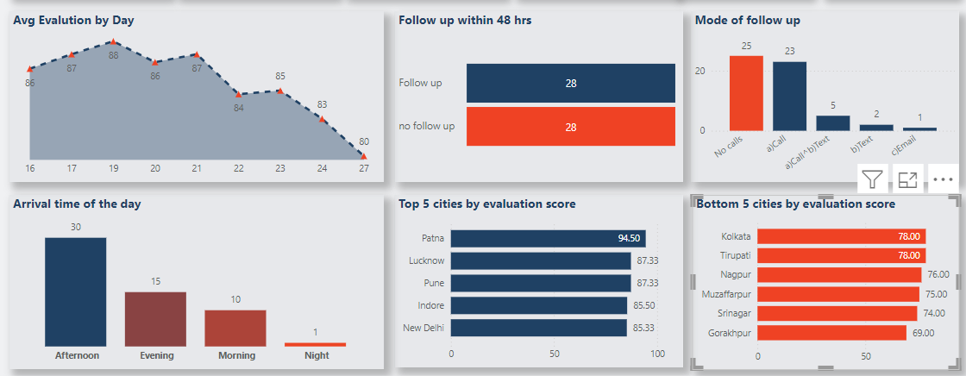
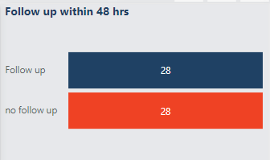
SUMMARY
Highest evaluation days are highest between 17-20 & highest week of day is Tuesday whereas lowest is Friday.
Follow up has to be increased for better student conversion.
Afternoon is the preferred time for students of visiting the centre. So, manpower has to be managed more in this period for customer satisfaction.
Kolkata and Tripura needs to give more focus on evaluation score, student engagement, knowledge, better customer experience.

Slide 6
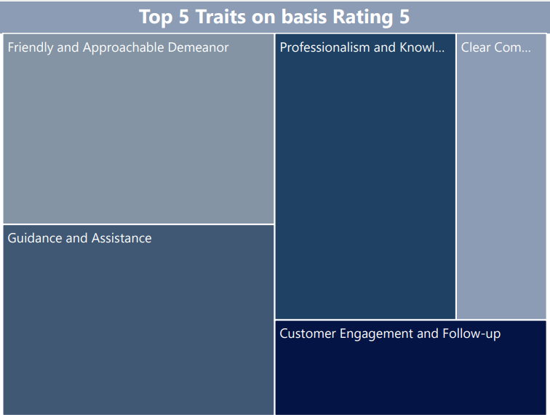
TOP 5 Traits
Guidance and assistance:
Provided helpful directions and guidance upon arrival.
Assisted with forms and information collection efficiently.
Customer engagement and follow up:
Prompt follow-up calls post-visit and inquiry.
Ensured customer satisfaction through courteous and
attentive handling of queries.
Professionalism and knowledge:
Exhibited a warm and welcoming attitude.
Displayed active listening skills and provided personalized advice.
Friendly & Approachable demeanor:
Demonstrated comprehensive knowledge of courses, fees, and
payment methods.
Handled objections effectively and maintained professionalism
throughout interactions.
Clear communication:
Communicated features and benefits clearly.
Offered thorough explanations of payment options and discounts.

Slide 7
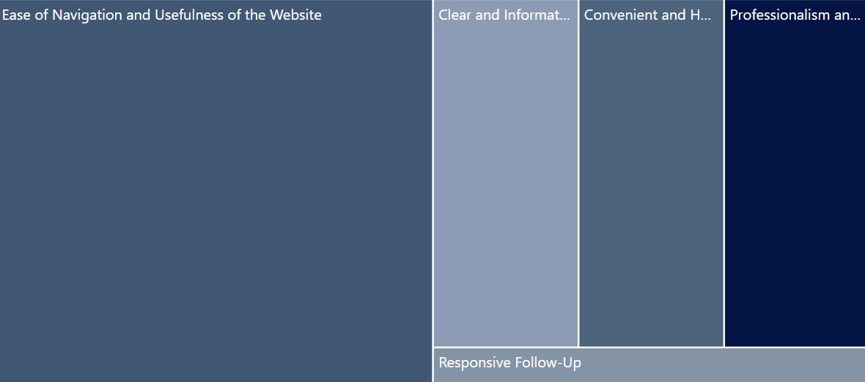

Factors for 5
Ease of Navigation and usefulness of the website:
Customers appreciating the website's visual appeal,
clear navigation, and informative program descriptions,
the availability of a booking option for center visits.
Clear and informative:
Providing detailed information about NEET, course fees,
discounts, and scholarship opportunities, explaining fee
structures, batch schedules, and special discounts.
Convenient and helpful guidance:
Receiving calls shortly after filling out inquiry forms,
specific instances where representatives followed up
to check if the customer had visited the center..
Professionalism & Politeness:
Representatives maintaining a professional demeanor and
politeness, courteous and respectful handling of customer inquiries and follow-ups.
Responsive follow up:
Representatives providing addresses and directions to the center, assisting with queries about the center's location, supportive interactions helping customers with the next steps after initial inquiries.

